Slide 1
International Vaccine Codes
September 2023

Slide 2
Agenda
Welcome & Introductions
WHODrug
Roundtable updates
Vaccine code set metrics
Next steps

Slide 3
Welcome
Purpose of call
Hear updates
Collect and analyze
Code set metrics
Central wiki page
Mappings?
In Scope
Vaccine code sets
National and universal
Technical/detail level
Out of Scope
Policy discussion
Which code sets to use
Software operation

Slide 4
Introductions
Name
Organization
What is the biggest challenge you are facing with vaccine code sets?

Slide 5
Roundtable Updates

Slide 6
Roundtable Updates
AIRA
Went to PAHO meeting in Santiago
Have worked on adverse reporting using WHODrug codes
Looking to do International Patient Summary (IPS) work in the future

Slide 7
Vaccine Code Set Metrics
Nathan Bunker, AIRA

Slide 8
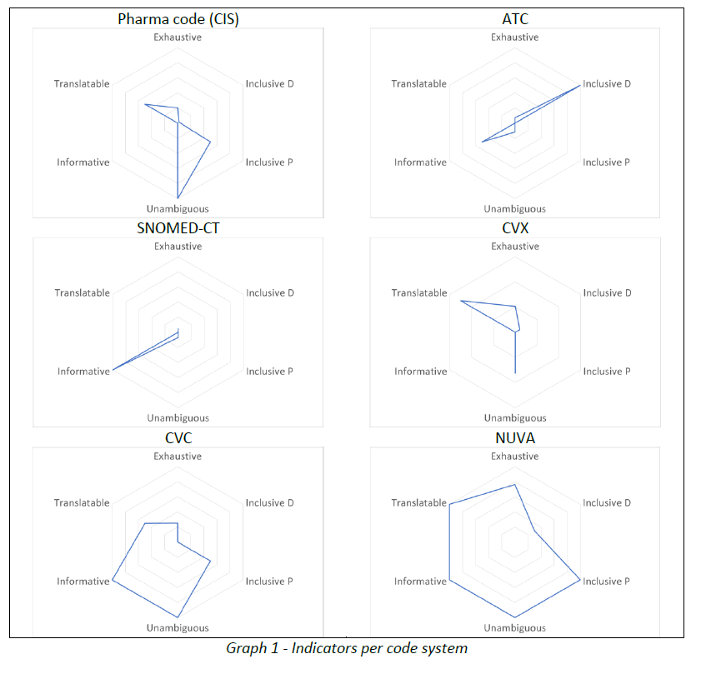
Code Set Metrics
Complete
Precise
Informative
Non-Specific
Historical
Mappable
Open Licensing
Process

Slide 9
Code Set Metrics
Vaccines we give now
Complete
Precise
Informative
Non-Specific
Historical
Mappable
Open Licensing
Process
Vaccines we used to give
Vaccines ever given to anyone
Vaccines given to anyone in the world

Slide 10
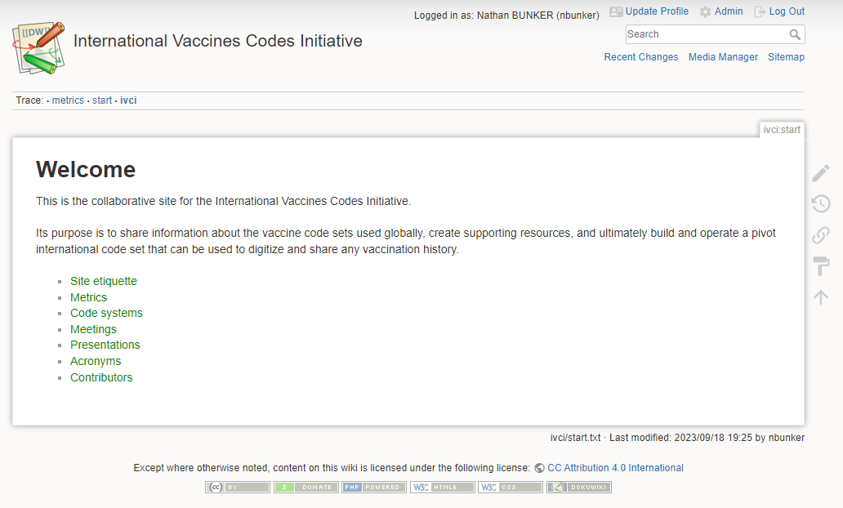

Slide 11
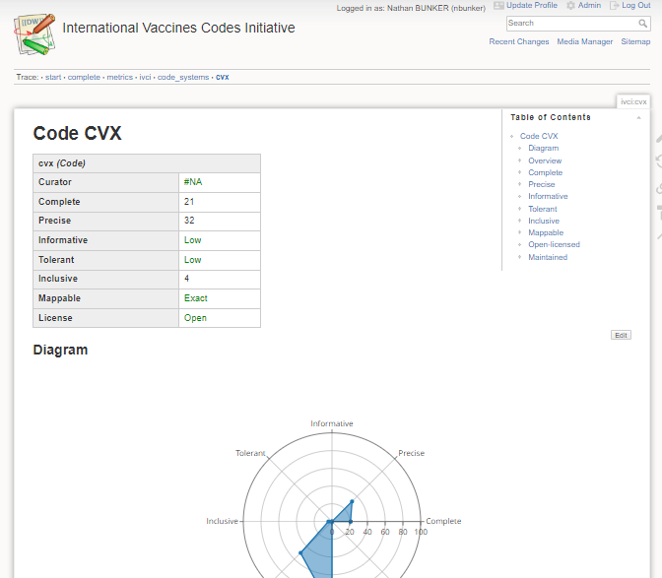
Next Steps
François and Nathan
Continue to refine metrics
Organize wiki
How can you help?
Please send us anything you know about code sets
Next month we’ll talk more about metrics

Slide 12
Next Steps
Nathan Bunker, AIRA

Slide 13
Future Discussions
What codesets do you want to learn more about?
SNOMED
Others?
Who else should we invite?
Pan American Health Organization (PAHO)
Metrics
Hoping to cover in more detail next month

