Slide 1
International Vaccine Codes
March 2024

Slide 2
Agenda
Welcome & Introductions
Roundtable updates
CVX Metrics
Next steps

Slide 3
Welcome
Purpose of call
Hear updates
Collect and analyze
Code set metrics
Central wiki page
Mappings?
In Scope
Vaccine code sets
National and universal
Technical/detail level
Out of Scope
Policy discussion
Which code sets to use
Software operation

Slide 4
Introductions
Name
Organization
What is the biggest challenge you are facing with vaccine code sets?

Slide 5
Roundtable Updates

Slide 6
Roundtable Updates
Canada
Questions to the group about processes used to update codes, especially during the pandemic
What are the key learnings for other country projects?

Slide 7
Roundtable Updates
USA
Some discussions about refugee records
Best practice indicates that all vaccinations should be recorded
We have some support already in CVX, especially for Covid
Need guidance and support for mapping
AIRA
Discussing need for more support for codes internationally
AIRA National Meeting – May 2024 – Orlando Florida
Other updates from USA?

Slide 8
Roundtable Updates
Other countries or projects?

Slide 9
Vaccine Code Set Metrics
Assessing the completeness and precision of a code system for administered vaccines

Slide 10
Overview
Big idea
Use NUVA as a common mapping language
Every code system maps to NUVA
NUVA has the definitive list of vaccinations
Generate metrics to give feedback

Slide 11
Assessing the completeness and precision of a code system for administered vaccines
March 2024
IVCI workgroup

Slide 12
Objective
Provide to code systems designers a tool to evaluate the ability of a code system to represent precisely and exhaustively every vaccination administration record.
Help them in improving their codifications.
Gather and distribute alignments across code systems.
March 2024
IVCI workgroup

Slide 13
Method
Based upon the unified nomenclature of vaccines NUVA, that:
Gathers the concepts from any available code system
Describes the function of each vaccine through its valences
Allows to navigate through different levels of precision with the hierarchy of valences.
Map every NUVA concept to the most precise possible equivalent in the candidate code system.
Completeness is the percentage of NUVA concepts that could be mapped
Precision is the average number of NUVA concepts that are confused within a same code from the candidate code system.
March 2024
IVCI workgroup

Slide 14
NUVA concepts
External codes (4846 in 18 codifications)
Vaccine code with used labels (995)
Valence (338)
Target disease (60)
Prevents
Contains
Exact Match
Counted on March 19th, 2024
March 2024
IVCI workgroup

Slide 15
Hierarchy of valences
Per Pertussis, unspecified
Acel Acellular pertussis, dose unknown
wP Whole-cell pertussis
ap Acellular pertussis, low dose
aP Acellular pertussis, normal dose
March 2024
IVCI workgroup

Slide 16
Illustrations
Completeness REPEVAX is a quadrivalent vaccine for Diphtheria, Pertussis, Poliomyelitis and Tetanus, with adult doses. There is no CVX code for such a combination (only CVX-130 for pediatric doses)
Precision The best CVX code for FLUENZ TETRA is CVX-111. It makes it undiscernible from 3 other vaccines.
Vaccine | Valence | Valence description | #
FLUENZ TETRA | Inf-4L | Quadrivalent live attenuated influenza vaccine | 1
CVX-111 | Inf-L | Influenza vaccine, live attenuated | 4
CVX-88 | Inf | Influenza vaccine, unspecified | 86
March 2024
IVCI workgroup

Slide 17
Mapping rule
If the NUVA code matches exactly an external code, then the mapping exists and is univocal (NUVA VAC0551 = CVX130)
Otherwise, the NUVA code is considered as mappable if:
It contains all valences of the candidate code (or more precise versions of the same valences)
It does not contain any valence that is not in the candidate code
Vaccine | Precise valences | Parent valences | CVX code
AMBIRIX | HepA-bv-PED | HepA-I | 104
 | rGBsAg-20 | HepB
March 2024
IVCI workgroup

Slide 18
Workflow for evaluation of a code system
Retrieve reference
Edit alignments
Evaluate
get_nuva_version
get_nuva
split_nuva
map_to_turtle
refturtle_to_map
eval_code
Edit CSV map
Toolset provided as a Python script nuva_utils.py (see https://ivci.org/doku/doku.php?id=ivci:nuva-utils for details)
March 2024
IVCI workgroup

Slide 19
NUVA Utils functions
Function | In params | Out params | In files | Out files
get_nuva_version |  | version
get_nuva | version |  |  | nuva_ivci.rdf
split_nuva |  |  | nuva_ivci.rdf | nuva_core.ttl nuva_refcode_CVX.ttl nuva_lang_fr.ttl
refturtle_to_map | CVX |  | nuva_refcode_CVX.ttl | nuva_refcode_CVX.csv
map_to_turtle | CVX |  | nuva_code_CVX.csv | nuva_code_CVX.ttl
eval_code | CVX | completeness precision | nuva_core.ttl nuva_code_CVX.ttl | nuva_reverse_CVX.csv nuva_best_CVX.csv
CVX can be replaced by any other code system.
March 2024
IVCI workgroup

Slide 20
CSV files contents
File | Columns | Descriptions
nuva_refcode_CVX nuva_code_CVX | CVX NUVA Label | CVX code Single equivalent NUVA code Label for NUVA code (optional)
nuva_reverse_CVX | CVX Label Count NUVA codes | CVX code Label for equivalent NUVA code Number of NUVA codes that can be represented by CVX code List of NUVA codes that can be represented by CVX code
nuva_best_CVX | NUVA Label Best CVX Count | NUVA code Label for the NUVA code Most precise CVX code (or None if not mappable) Number of undistinguishable NUVA concepts within the best CVX code
March 2024
IVCI workgroup

Slide 21
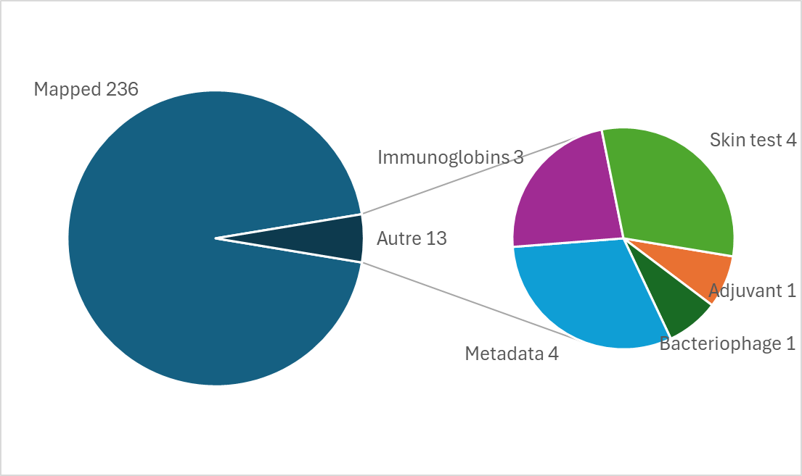
Mapping CVX codes to NUVA
March 2024
IVCI workgroup

Slide 22
Unmapped CVX codes
Reason | # | CVX Codes
Adjuvant | 1 | 801
Bacteriophage | 1 | 76
Metadata | 4 | 99, 314, 998, 999
Immunoglobins | 3 | 156, 157, 159
Skin test | 4 | 95, 96, 97, 98
It may be normal to have unmapped codes, depending upon the purpose of the code system (e.g. NDC for all drugs, not only vaccines)

Slide 23
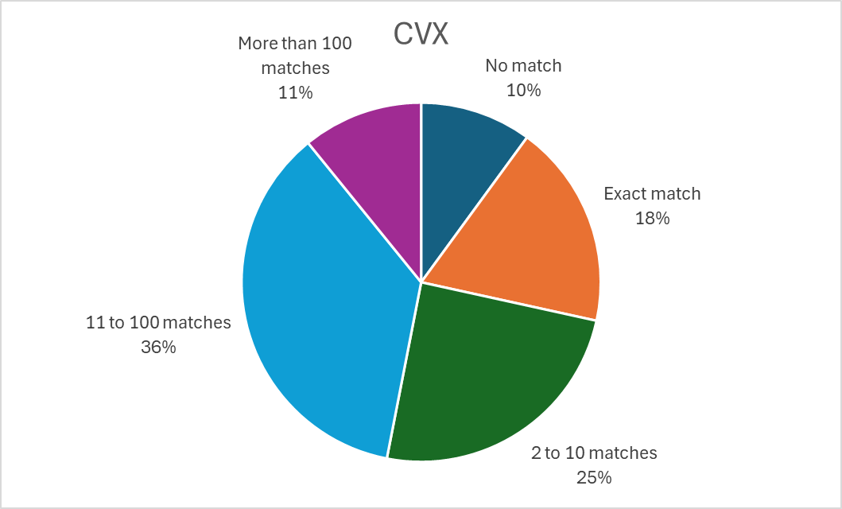
Metrics for CVX
Completeness | 90%
Precision | 3.5%
Slice | #CVX | #NUVA
0 | - | 100
1 | 183 | 183
2-10 | 76 | 245
11-100 | 29 | 359
>100 | 1 | 108
Number of undistinguishable concepts per NUVA code See generated nuva_best_CVX.csv for details
March 2024
IVCI workgroup

Slide 24
Metrics for other code systems
Based upon existing alignments with NUVA.
Code System | Completeness | Precision
CVX | 90 | 3.5
ATC | 87 | 4.0
CIS (French pharma code) | 18 | 100
SNOMED-CT GPS | 81 | 0.6
March 2024
IVCI workgroup

Slide 25
Next metric to be implemented : redundancy
Some code systems, according to their purpose, differentiate vaccines along criteria that are not relevant for long-term vaccination history:
Packaging (logistics)
Administration route (adverse effects following immunization)
Adjuvants
etc.
In that case several codes match with a same NUVA code.
Redundancy is the share of codes in the code system that are not unique for a given NUVA code.

Slide 26
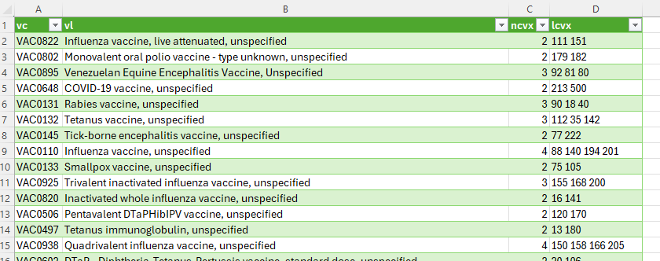
Redundancy for CVX
43 codes out of 236 are redundant, giving a redundancy index of 18%

Slide 27
What you can do
Download and run the script
Extract and update mappings for your preferred code systems (NUVA codes can be searched at https://nuva.mesvaccins.net)
Get the metrics, tune codes and mappings
Once satisfied, please share your mappings with us for inclusion into the NUVA reference.
March 2024
IVCI workgroup

Slide 28
Any questions ?
François KAAG
+33 766 44 43 46
fkaag@syadem.fr
Louise BOURGES
+33 671 33 20 36
lbourges@mesvaccins.net
Jean-Louis KOECK
+33 647 88 63 33
jlkoeck@syadem.fr
March 2024
IVCI workgroup

Slide 29
Next Steps
Nathan Bunker, AIRA

Slide 30
Future Discussions
Next Meeting
April 17
Upcoming topics
SNOMED
What do you want to know more about?

